Slide 1
Hackathon 2026 CodeGuard AI
Aguilar Obando, Alvaro
Blandon, Enjells J
Orellana Pineda, Cesar
Oviedo, Nelson
Vargas Aguero, Esteban

Slide 2
Test cases problems
Creating test cases takes time
Set-up needed to start a small test (Install apps, troubleshoot, research, etc)
Even with AI, you need to manually explain what the code changes are
Existing tests become outdated when UI changes and nobody updates them

Slide 3
Git-Aware AI Test Generation
Zero-effort for you, Just create a Git Pull Request
No need to explain the code, the tool will read it for you
Detailed reports by Playwright

Slide 4
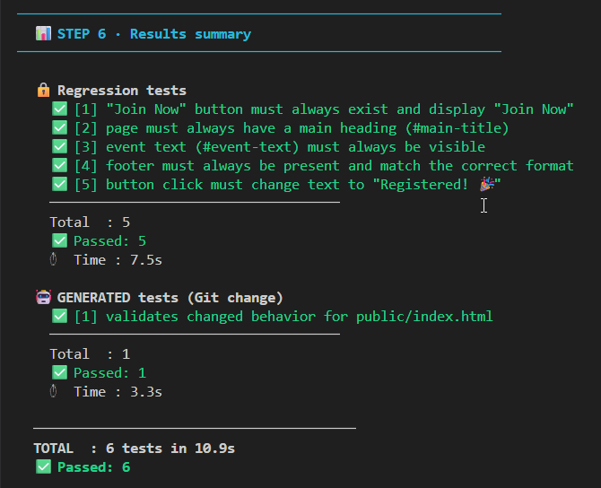



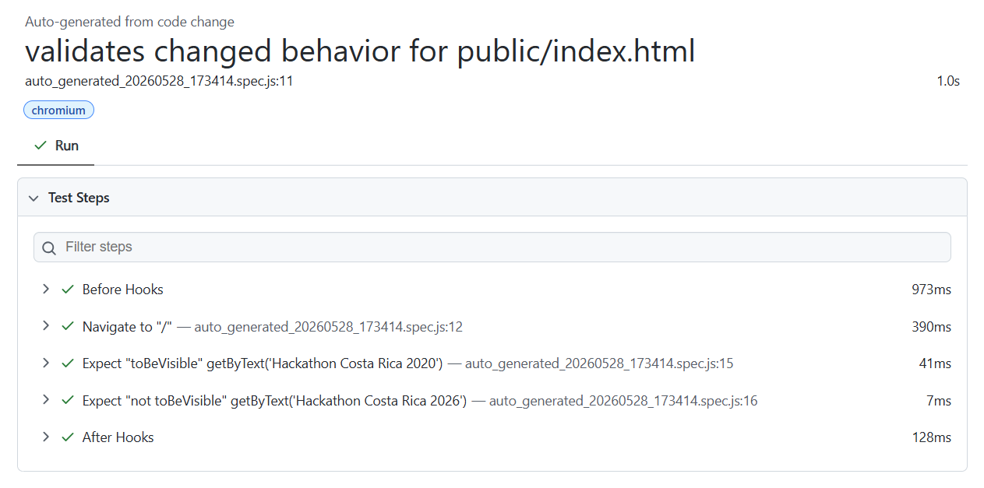
Long term vision
Pull Request
created on GitHub
Sent by Webhook event
Read the changes, create and run test cases in the server

Slide 5

Demo
Local commit
Local server

Slide 6
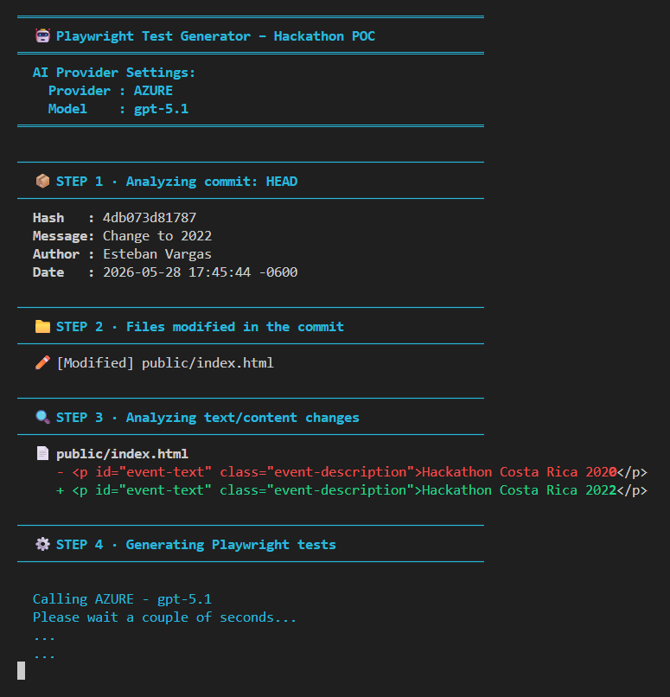
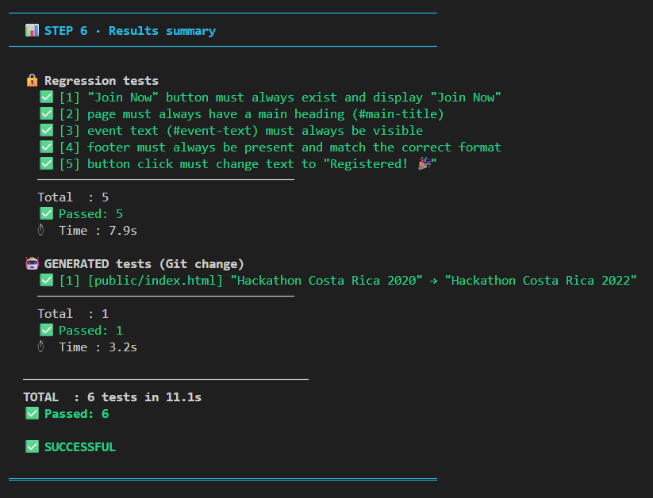
Demo

Slide 7
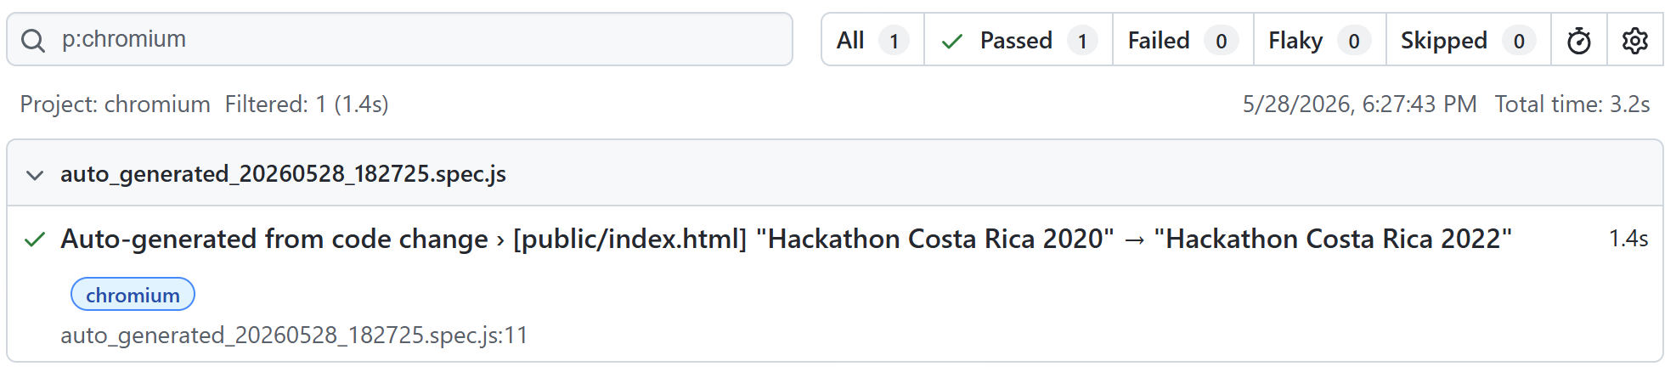
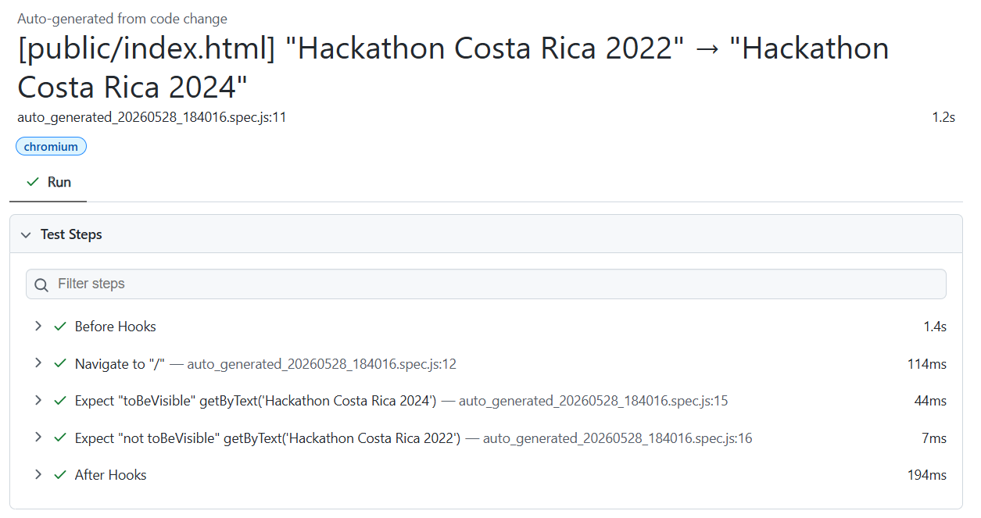
Demo

Slide 8
Q&A

Slide 9
Hackathon 2026 CodeGuard AI
Aguilar Obando, Alvaro
Blandon, Enjells J
Orellana Pineda, Cesar
Oviedo, Nelson
Vargas Aguero, Esteban

